Slide 1

Capstone Project

Slide 2



Personal BACKGROUND
(Name, Past Experience, Qualification, Career Summary)
Name : Hariharan Mohan
Past Experience : Fresher
Qualification : B.E Computer Science and Engineering
Career Summary : I am a recent B.E CSE graduate with proficiency in Java, C, C++ and MySQL.
www.collaberadigital.com

Slide 3


Key Takeaways/Learnings from the Program (HTD)
Java with OOP: Develop and maintain Java applications using Object-Oriented principles.
JUnit: Create unit tests to ensure code quality.
SDLC and Agile: Apply SDLC and Agile methods for project management
.
RESTful APIs: Build and manage RESTful APIs with Spring Boot.
Microservices: Design scalable microservices architectures.
Time Management: Optimize productivity with effective time management.
Generative AI: Explore the impact of generative AI on development.

Slide 4

Problem Statement of the Capstone Project
Development of an Online Shopping System Using Spring Boot with RESTful APIs

Slide 5
Outline of the Implementation
Entity Classes for Data Modeling: The goal is to create a clear and organized representation of the data used in the online shopping system. Entity classes define the structure of your database tables and encapsulate business logic related to the data, ensuring a consistent and reliable data model that supports operations like CRUD (Create, Read, Update, Delete).
REST Controllers for API Design: Controllers act as the interface between the client and server. The goal is to implement RESTful endpoints that handle incoming HTTP requests, interact with the service layer, and return appropriate responses. This separation allows for clean API design, making it easier to manage and scale the system.
Separation of Concerns: By using entity classes and controllers, the project aims to adhere to the SOLID principles, specifically the Single Responsibility Principle. Entity classes manage data and business logic, while controllers handle request processing and response generation, leading to a more modular and maintainable codebase.

Slide 6
Reason to choose Spring Boot for this Project
Simplified Configuration: Spring Boot offers a streamlined setup with auto-configuration and sensible defaults, reducing the need for extensive XML configuration and boilerplate code. This allows you to focus on developing features rather than configuring the framework.
Rapid Development: With built-in tools and starter projects, Spring Boot accelerates development by providing ready-to-use dependencies and a robust environment. This helps you quickly set up REST controllers and integrate various components of your online shopping system.
Microservice Support: Spring Boot's support for microservices aligns well with SOLID principles, promoting single responsibility and separation of concerns. It enables you to build and deploy modular, scalable components efficiently, which is ideal for an online shopping system.
Enhanced Testing and Maintenance: Spring Boot includes features like embedded servers and comprehensive testing support, making it easier to write and run tests. This facilitates adherence to SOLID principles by ensuring that your system remains maintainable and reliable over time.

Slide 7

Dependencies used in this project
Lombok: Reduces boilerplate code by automatically generating getters, setters, constructors, and other common methods.
Spring Web: Provides the infrastructure for building web applications, including RESTful services and MVC components.
JDBC API: Facilitates direct interactions with the database using standard Java database connectivity for executing SQL queries.
Spring Data JPA: Simplifies data access by providing a higher-level abstraction over JPA for managing database operations and queries.
MySQL Driver: Enables connectivity to MySQL databases, allowing the application to interact with MySQL for data storage and retrieval.

Slide 8

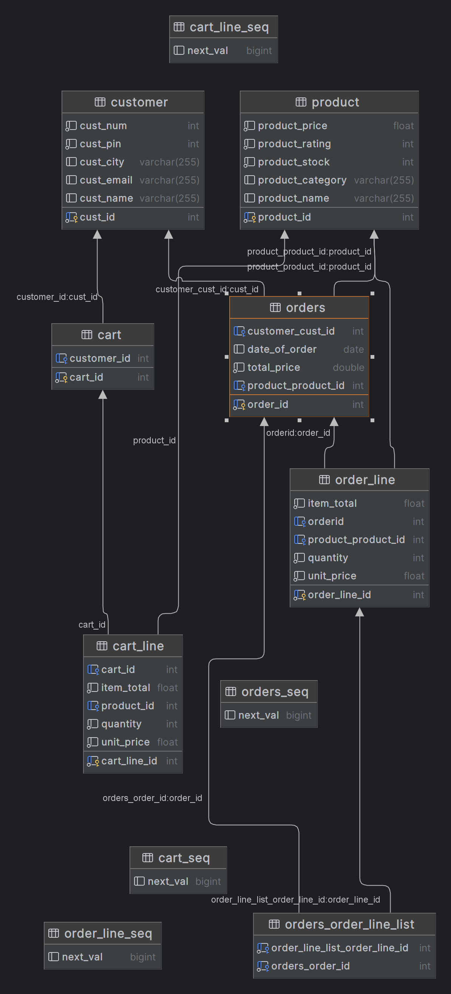
Entity Diagram of the Online Shopping System

Slide 9
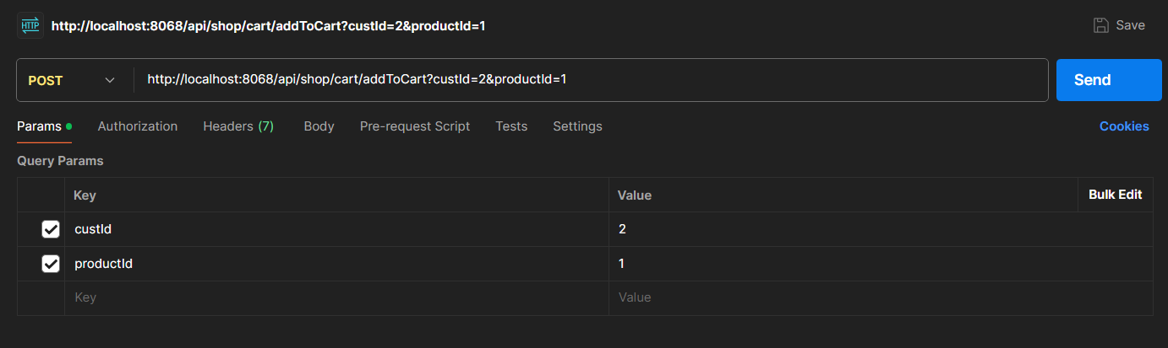
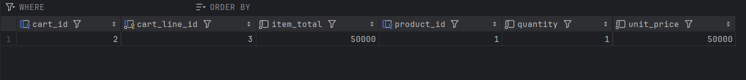
Important areas of the Project with screenshots
Add to cart function implementation

Slide 10
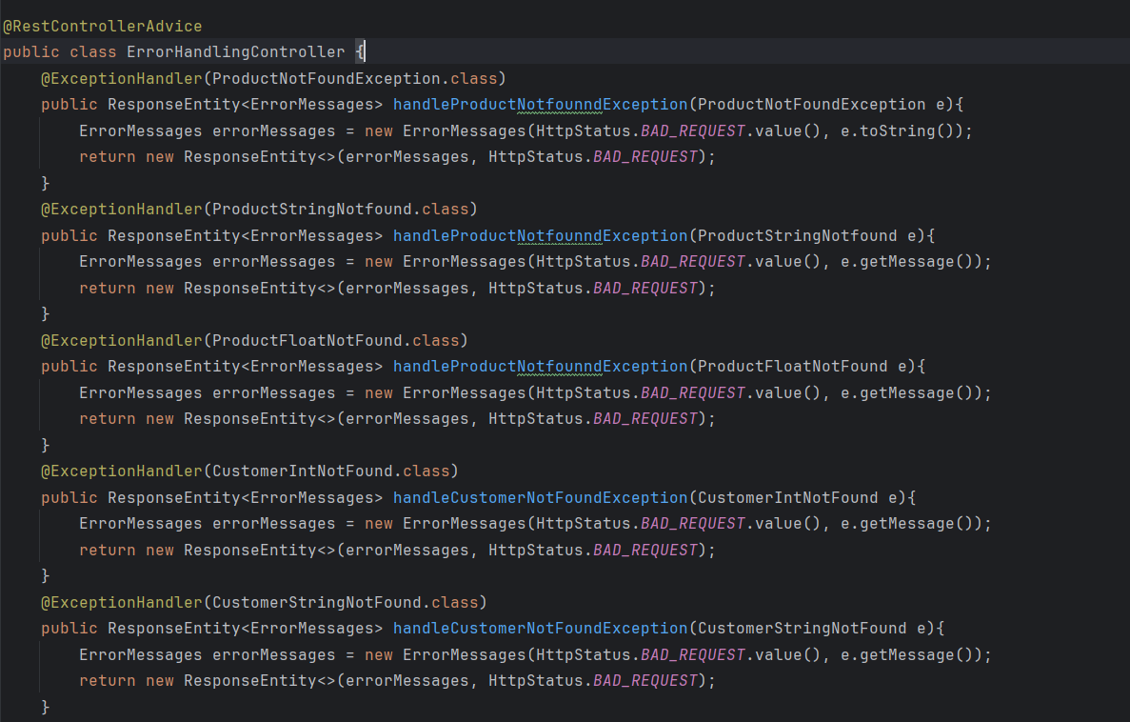
Important areas of the Project with screenshots
Exception Handling Controller

Slide 11
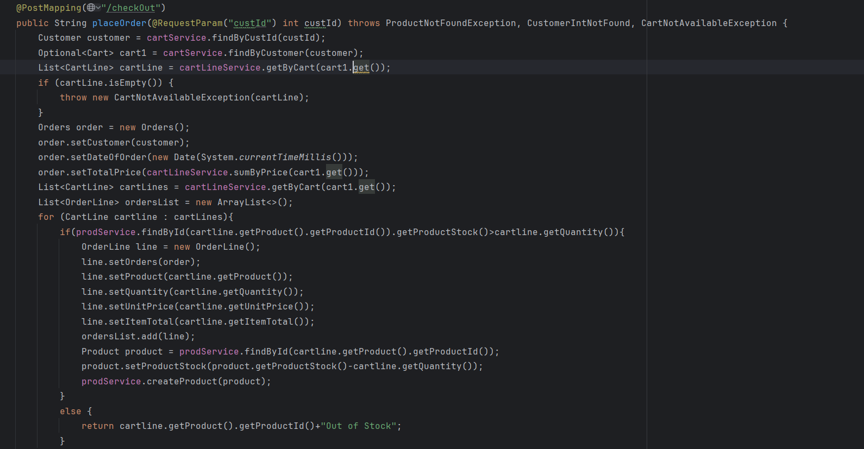
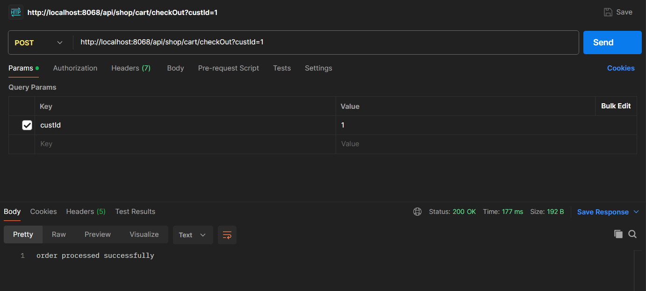
Important areas of the Project with screenshots
Order Processing Implementation

Slide 12
Creating this online shopping system with Spring Boot, entity classes, and REST controllers has deepened my understanding of modern software design and development. I have learned to apply SOLID principles for a maintainable codebase, leverage Spring Boot for rapid development, and build scalable RESTful APIs. This project has provided a solid foundation in integrating these technologies effectively.
Conclusion

Slide 13
Thank You

